Slide 1
به نام خدا
برخورد یون های سنگین در LHC
محمد علی اکبری
پژوهشگاه دانش های بنیادی – پژوهشکده ذرات و شتابگر
همایش یک روزه فیزیک LHCبا تاکید بر هیگز

Slide 2
Standard Model
H : Higgs boson

Slide 3
Perturbation
Harmonic oscillator
is a small number.
In the QFT

Slide 4
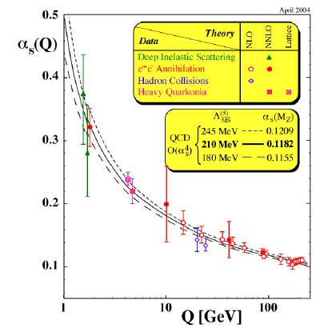
The Nobel Prize in Physics 2004
David J. Gross, H. David Politzer, Frank Wilczek

Slide 5
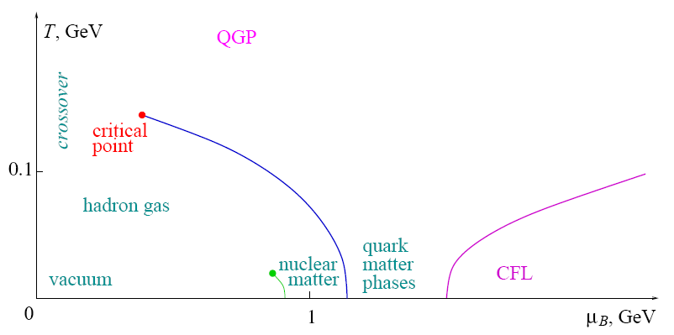
QCD phase diagram
QGP(200 Mev~10^12 K)

Slide 6
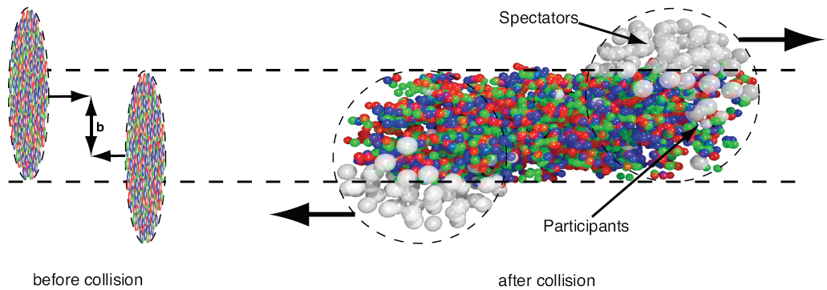
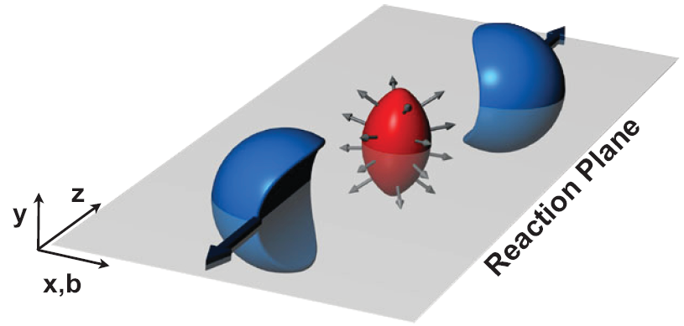
Relativistic Heavy Ion Collision
1. Gold-Gold collision.
2. Center of mass energy: 200 Gev.

Slide 8
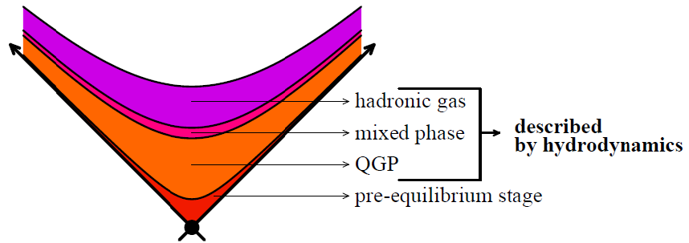
Thermalization time
Boost invariant
parameter

Slide 9
Hydrodynamics
Hydrodynamic equations
Energy-momentum
tensor
(Ideal fluid)
Dissipative part
Shear viscosity

Slide 10
Properties
1. Thermalization time .
2. Elliptic flow.
3. Shear viscosity.
4. Jet quenching parameter.
5. Quarkonia Suppression.
6. Chiral magnetic effect.

Slide 11
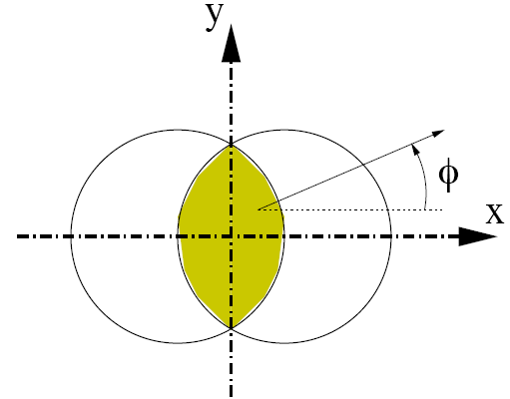
Elliptic flow
Symmteries:
Elliptic flow

Slide 12
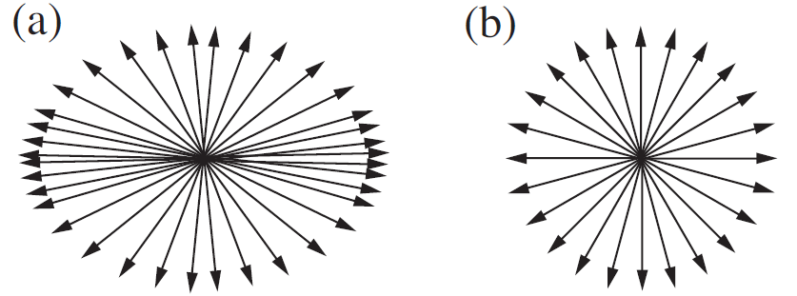

Slide 13
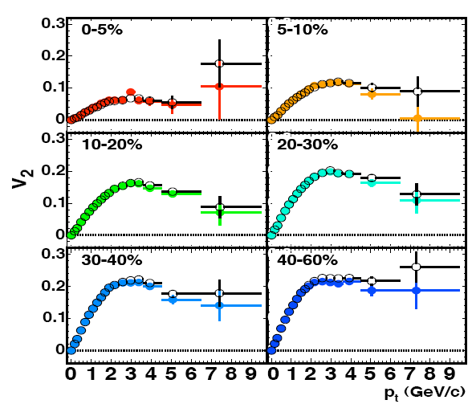

Slide 14
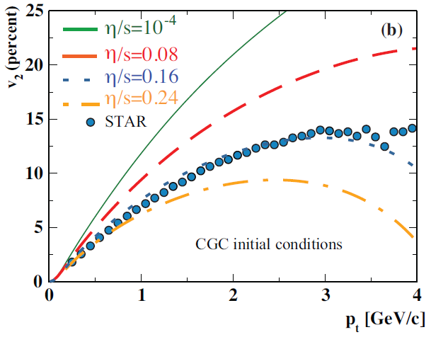
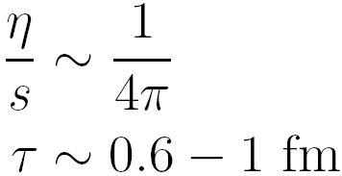
Shear viscosity

Slide 15
Jet quenching
Jet quenching refers to a suite of experimental observables that
together reveal what happens when a very energetic quark or
gluon (with momentum much greater than the temperature) plows
through the strongly coupled plasma.
?

Slide 16
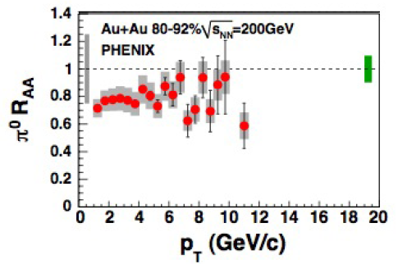
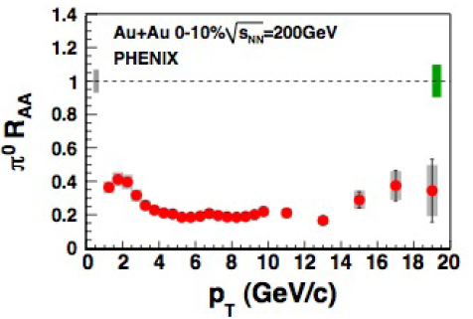
Nuclear modification
factor

Slide 17
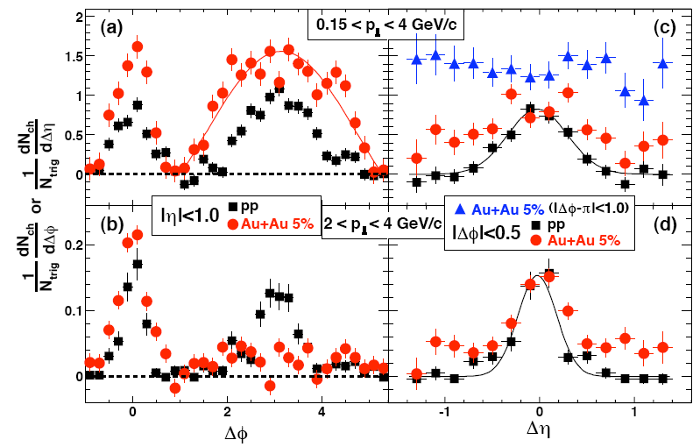

Slide 18
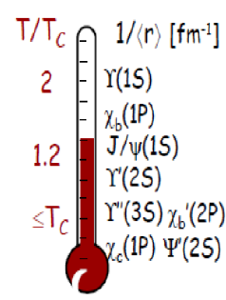
Quarkonia Suppression
Quarkonia: Mesons made of a heavy quark-antiquark pair. They are
significantly smaller than typical mesons or baryons.

Slide 19
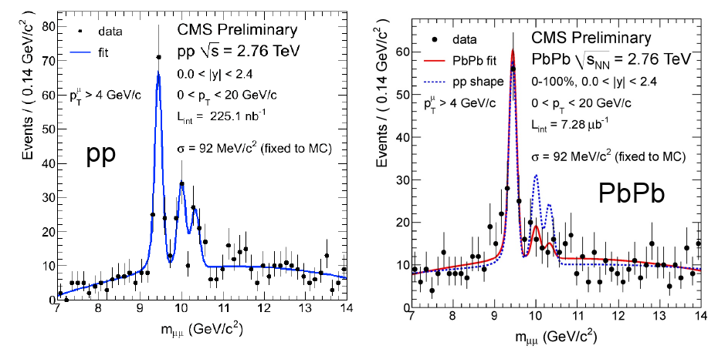
ϒ(2S+3S) Suppression

Slide 20
خیلی هم ممنون

