Slide 1
بسم الله الرحمن الرحیم
Modulator & Power supply
for
High power Microwave Tube
in
LINAc accelerator

Slide 2
Twystron Tube
Specification:
S-band (2950-3050 MHz)
Input RF power : 2kW
Out put RF Power : 2MW
PRF: 100Hz
1
2
3
5
7
4
6
1 RF Input
2 RF output
3 Cathode
4 filament
5 Focus Coil
6 Ion vacuum pump
7 collector

Slide 3
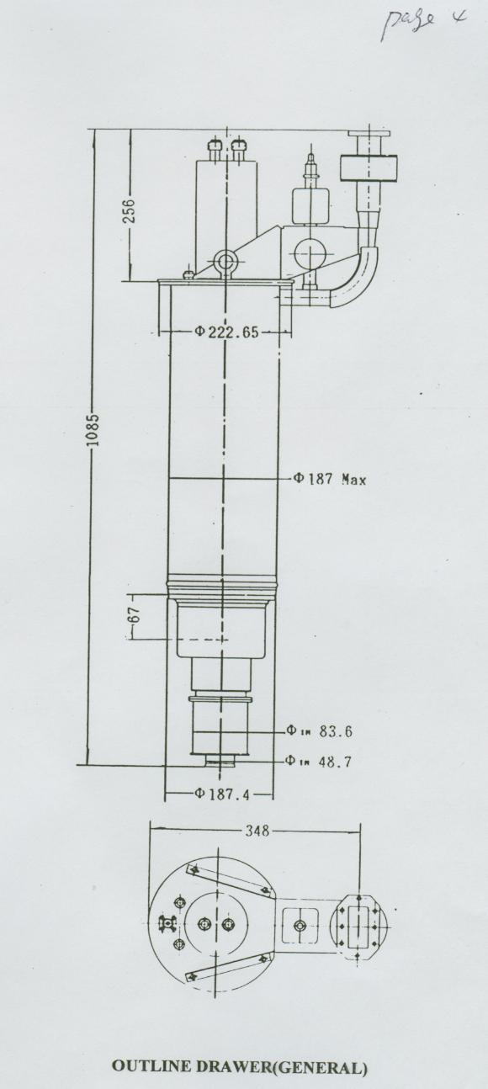
Tube

Slide 4
Tube

Slide 5
Driving Assembly Block Diagram
2KW RF Ass.
Coupler
Mode Converter
Waveguide
Isolator
Cooling
HV Pulsed power Modulator
Twystron Tube
Thermionic PS
.Focus Coil PS
Vacuum PS
.Pressure Pump

Slide 6
Other Tube Power Supply
Filament Power Supply
Focus Coil Power Supply
Parameter | Value
Voltage | 8V
Current | 35A
Mode | DC
Type | SMPS
Parameter | Value
Voltage | 60V
Current | 17A
Mode | DC
Type | SMPS
Vacuum Ion Pump Power Supply
Parameter | Value
Voltage | 3kV
Current | 20mA
Mode | DC
Type | SMPS

Slide 7
Cooling Assembly
Thermometers
Thermostat
Pressure gauge
Flow controller
Circulation pump
condenser
Filter Ass.
It uses for cooling both isolator and Twystron Tube

Slide 8
Pressure Assembly
Storage tank
manometer
Circulation pump
Drying ass.
Filter ass.
It uses for pressurizing microwave assemblies after tube

Slide 9
Microwave Assembly
Pressure Ass.
FPA Output
2MW RF
Isolator
TE₁₀
Coupler
Mode Converter
TM₀₁
2KW RF input
Disconnection RF Switch
peak detector
Waveguide
Cavity

Slide 10
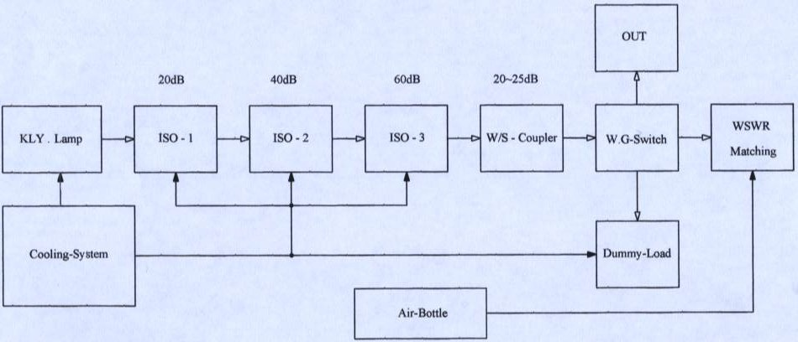
Microwave Assembly

Slide 11
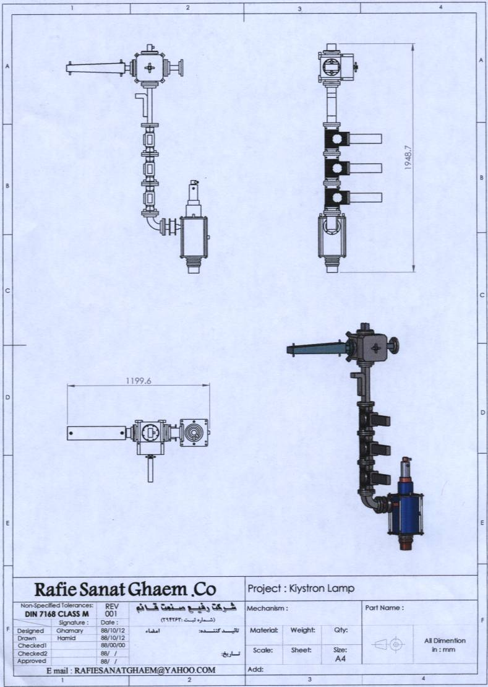
Microwave Assembly

Slide 12
Control System
AC Power
PS control:
Filament Power Supply
Focus Coil Power Supply
Vacuum Ion Pump Power Supply
Pulsed Power Modulator
RF Reflection control
Cooling Assembly
Pressure Assembly

Slide 13
HV Modulator specification
Input:
3Ph , 30KVA, 380V ± 15%
Temperature: 0°C ~ 50°C
Humidity: 5% ~ 90% non-condensed
Output:
Filament:
27V/100A, ripple 0.25%, η > 80%, short circuit & Over voltage protection
Focus coil:
270V/12A, ripple 0.25%, η > 80%, short circuit & Over voltage protection
Ion Pump:
3KV/20mA, ripple 0.25%, η > 80%, short circuit & Over voltage protection

Slide 14
Modulator:
115KV adjustable, 80A
Pulse duration: 2 ~ 7µs adjustable
Pulse rate: 80 ~ 120Hz adjustable
Ripple: 0.25%
η: 80%
Protection:
Short- circuit
Over voltage
Filament power on sequence
Over temperature

Slide 15
HV Pulsed Power Modulator
Low Ripple DC rectifier
500VDC
Fly Back SMPS 3kV
3KV/100Hz
HV shunt regulator
Regulated
3KV/100Hz
Peaking Switch
3ᵠ380v
AC&EMI filter ass.
PF Network
parameter | value
Peak voltage | 110kV
duration | 7.5us
Current | 70A
PRF | 100Hz
1.5KV rectangular wave
Pulse Trans
110kV/100Hz

Slide 16
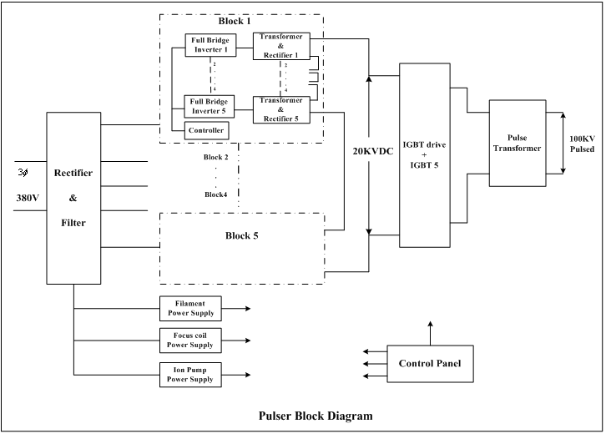

Slide 17
Systems Sections :
Inverter Section
Pulser Section
Output Pulse Transformer
Filament Power Supply
Focus Coil Power Supply
Ion Pump Power Supply
Control Panel

Slide 18
Systems Sections (Continue)
Inverter Section
Comprise 6 blocks of Inverter Block
Each block comprise 5 inverter module
Each block has a inverter controller

Slide 19
Inverter Sections (Continue)
Inverter module
Flyback topology driver
Transformer with high isolation withstand
High voltage Isolator for feedback
Output Rectifier
Output Filter
Control Circuit
Output up to 1KV

Slide 20
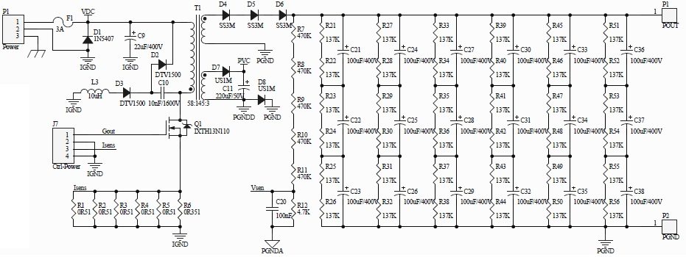
Inverter Sections (Continue)
Inverter module

Slide 21
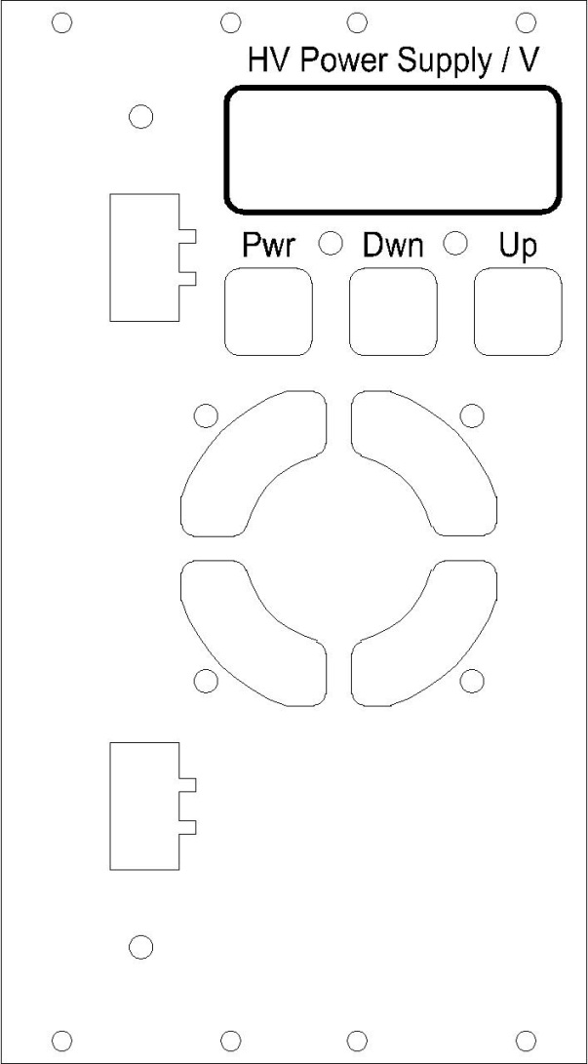
Inverter Sections (Continue)
Inverter module

Slide 22
Inverter Sections (Continue)
Inverter controller
Input filter
PFC (Power Factor Corrector)
Rectifier
Output : constant HVDC
Controller
Interface : 2-way
Interface 1: with inverter modules
Interface 2: with control panel

Slide 23
Inverter Sections (Continue)
Inverter controller

Slide 24
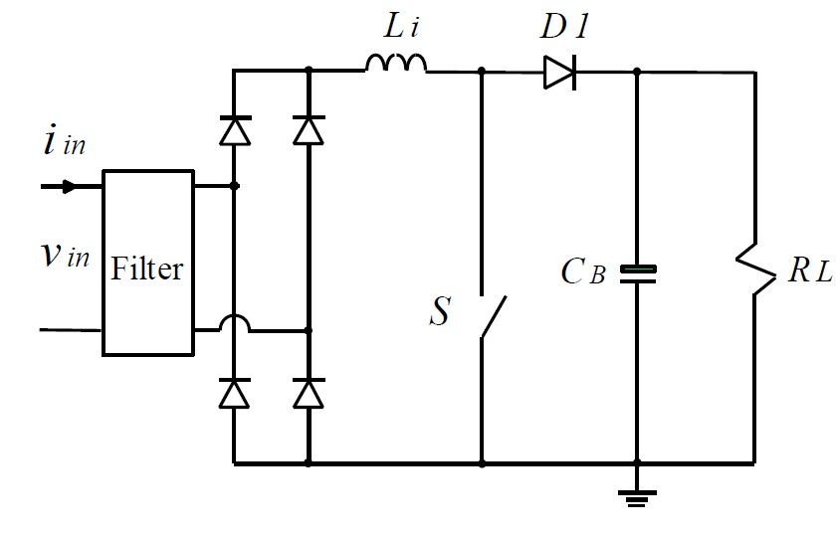
Inverter Sections (Continue)
Inverter controller power stage

Slide 25
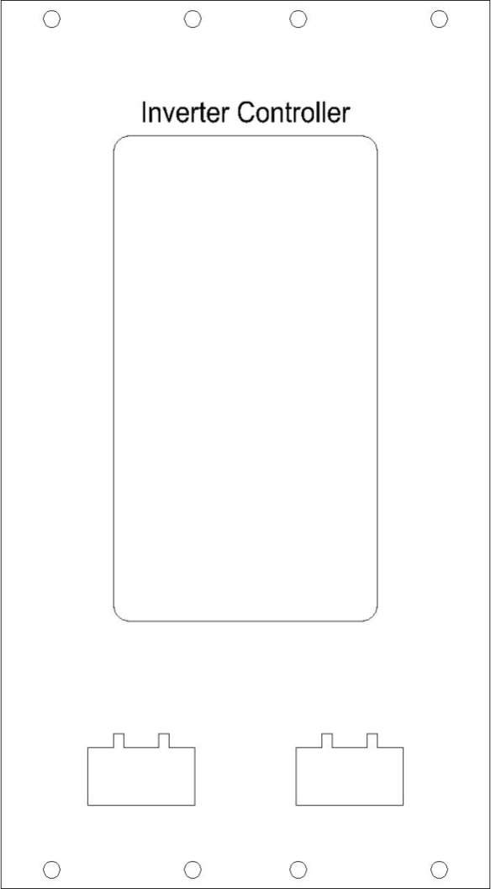
Inverter Sections (Continue)
Inverter controller

Slide 26
Inverter Sections (Continue)
Inverter module

Slide 27
Systems Sections (Continue)
Pulser Module
IGBT driver
IGBT device
Control Circuit
Any IGBT block comprise 5 IGBT module
System consist of 6 IGBT block

Slide 28
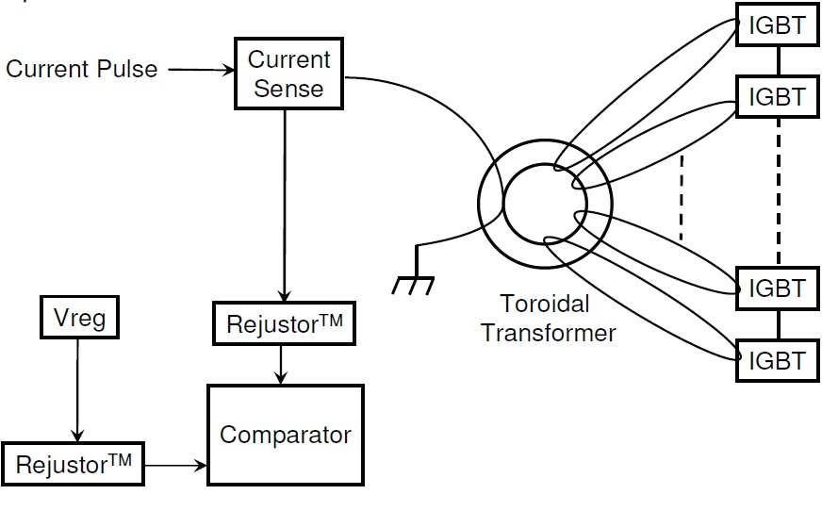
Systems Sections (Continue)
Pulser Module

Slide 29
Systems Sections (Continue)
Filament Power Supply
Input filter
PFC (Power Factor Corrector)
Rectifier
Full bridge driver
Full bridge MOSFET
Transformer
Output Rectifier
Output Filter
Control Circuit

Slide 30
Systems Sections (Continue)
Focus Coil Power Supply
Input filter
PFC (Power Factor Corrector)
Rectifier
Full bridge driver
Full bridge MOSFET
Transformer
Output Rectifier
Output Filter
Control Circuit

Slide 31
Systems Sections (Continue)
Ion Pump Power Supply
Input filter
PFC (Power Factor Corrector)
Rectifier
Full bridge driver
Full bridge MOSFET
Transformer
Output Rectifier
Output Filter
Control Circuit

